Slide 1


1
PRESENTING “∅ WASTE”
“The next gen solution towards smart waste management”

Slide 2
MEET THE TEAM!
2
Sagnic Basu
Dwip Brahma
Souradeep Das

Slide 3
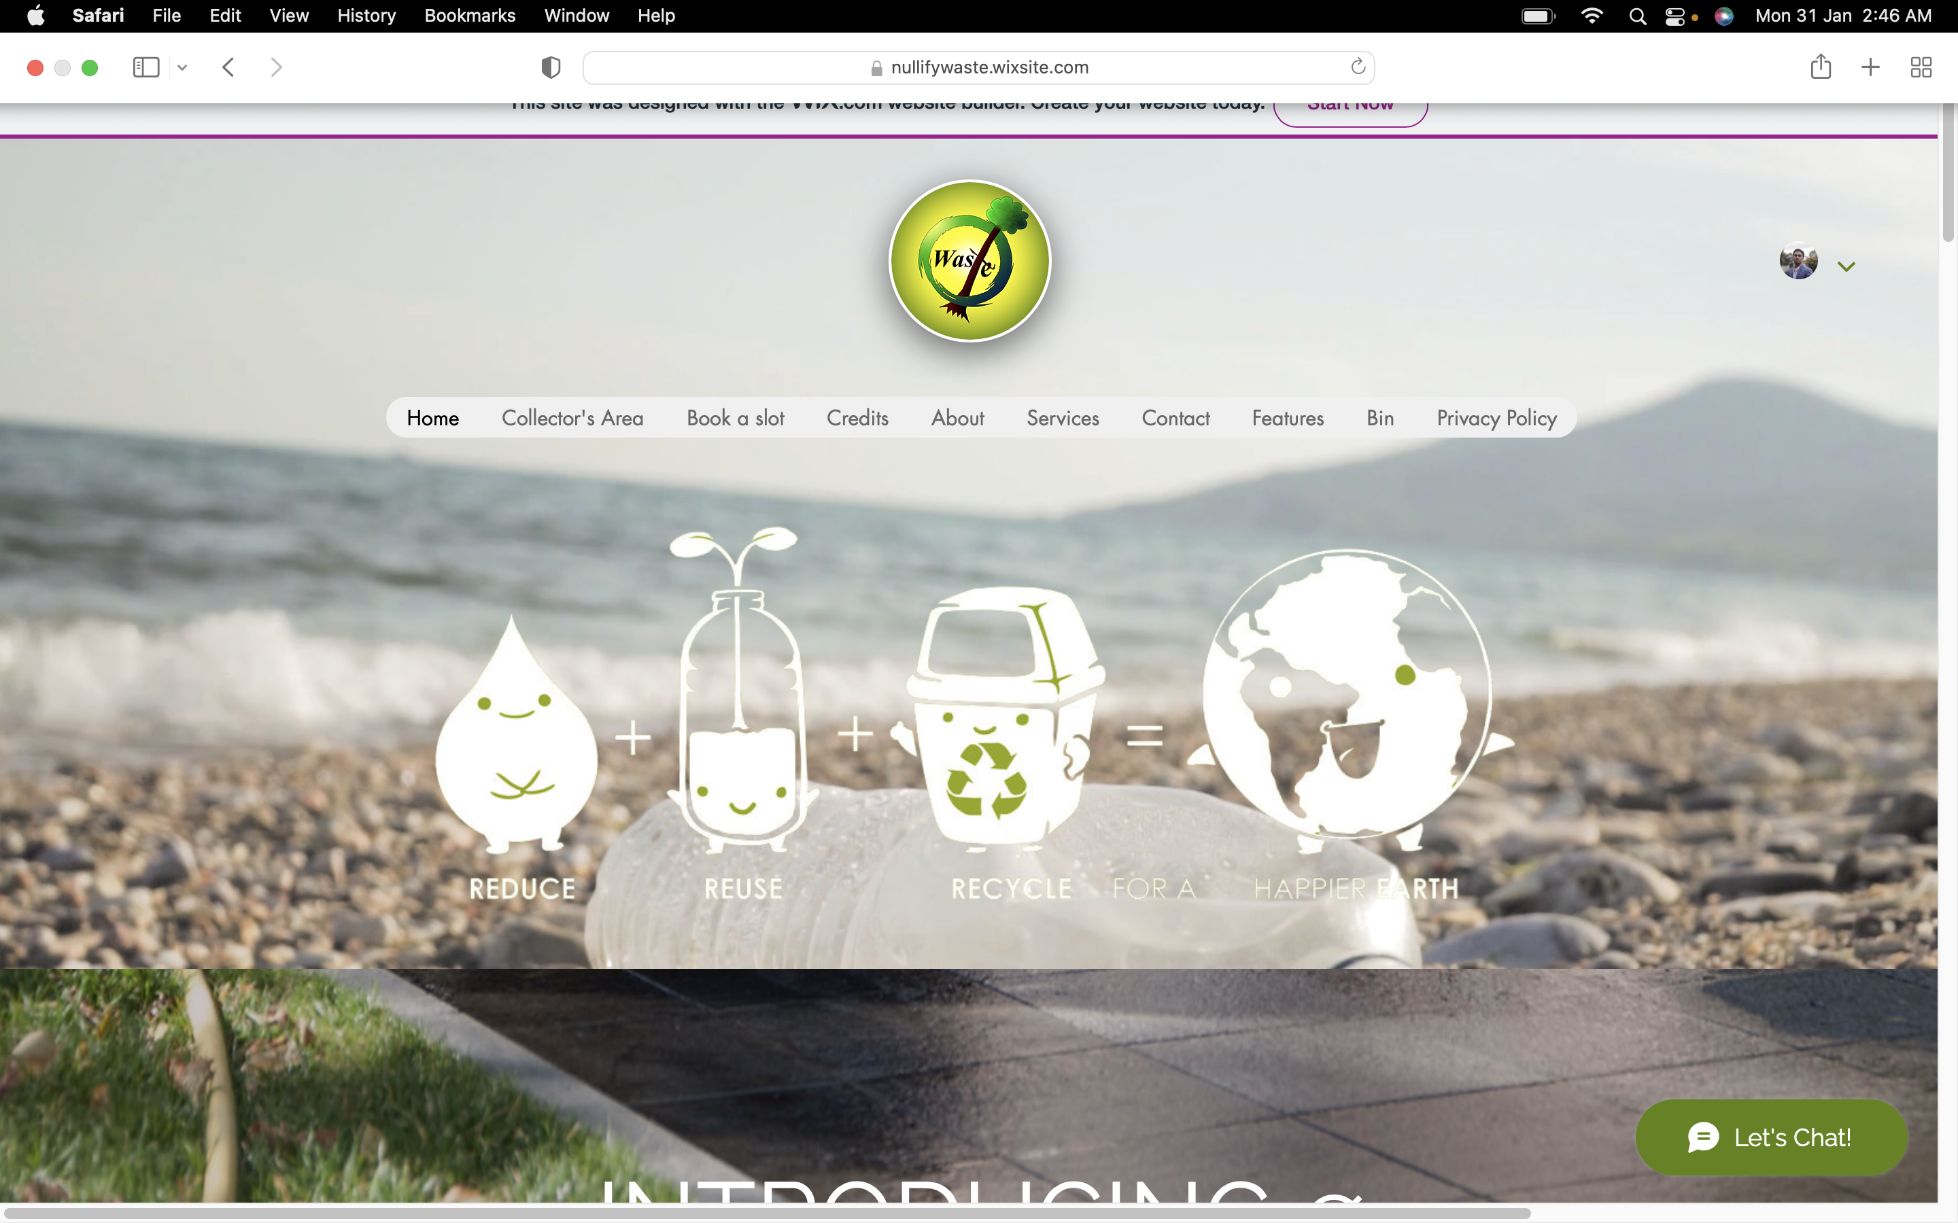
A quick tour of our website
3
Home
The home page presents to the viewer the basic interface. The user can navigate through all pages smoothly with a few clicks.

Slide 4
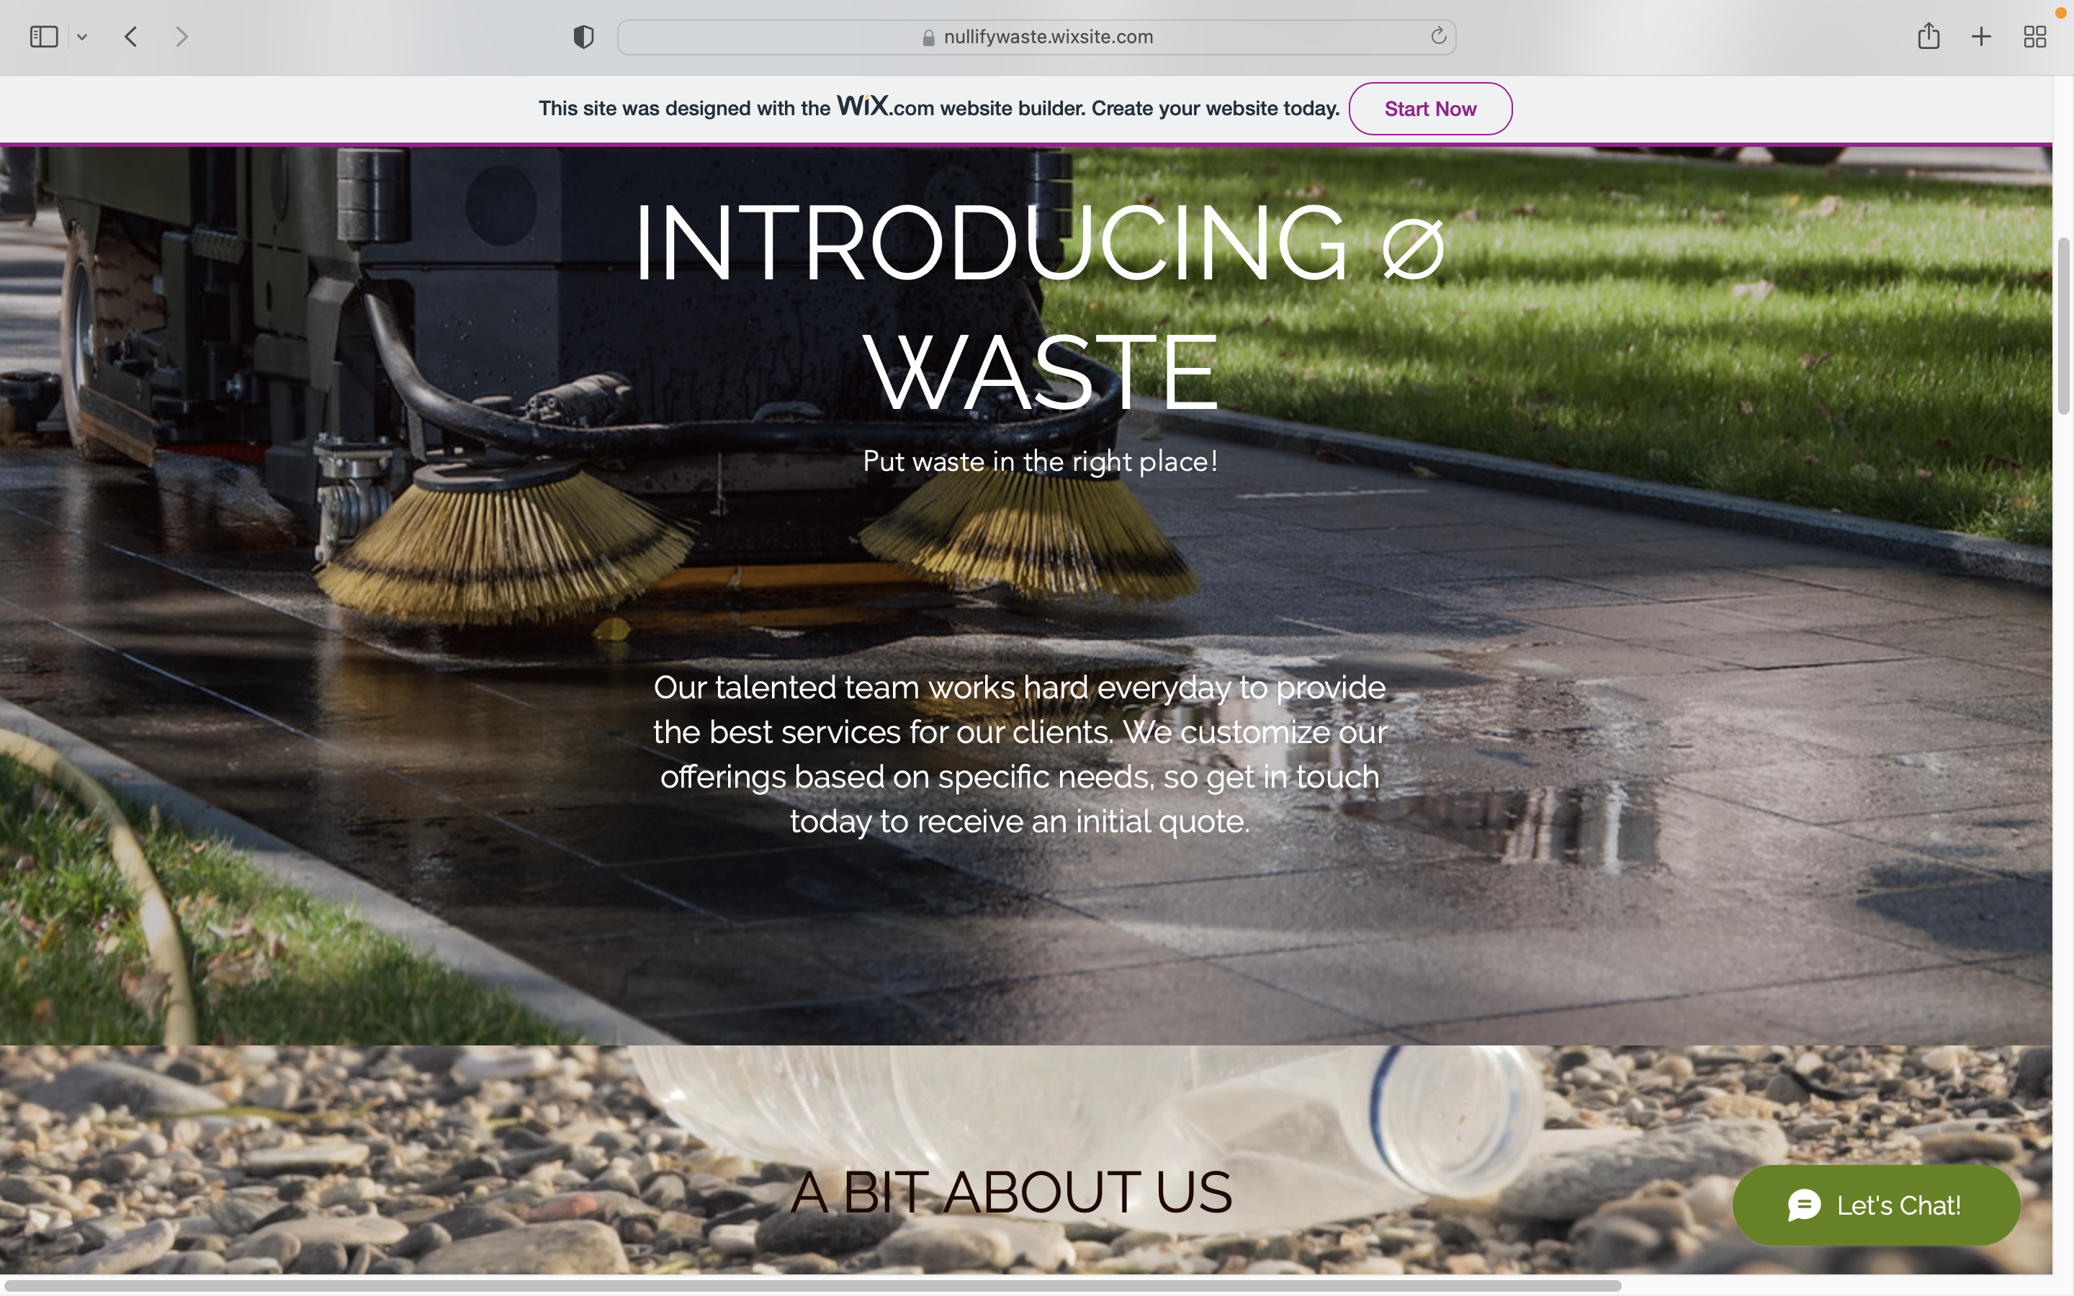
A quick tour of our website
4
Home
The page provides a brief description of our team, and the specific goal set we are targeting to achieve.

Slide 5
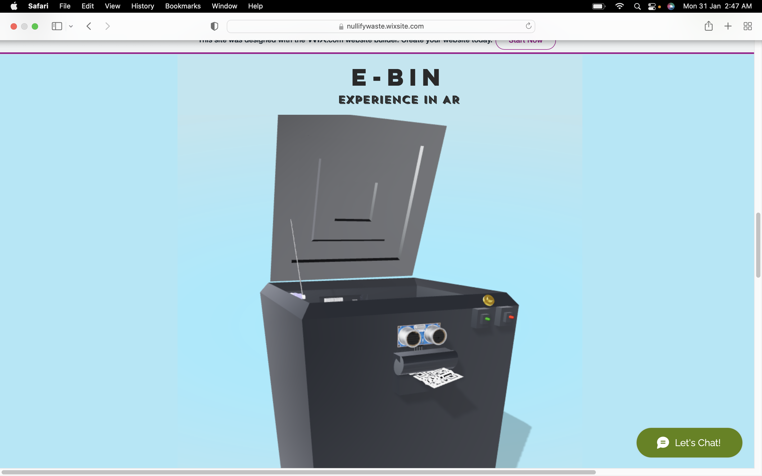
A quick tour of our website
5
Home
The home page also contains an interactive model of the smart bin, 3D rendered in Blender, inculcating the use of Augmented Reality.

Slide 6
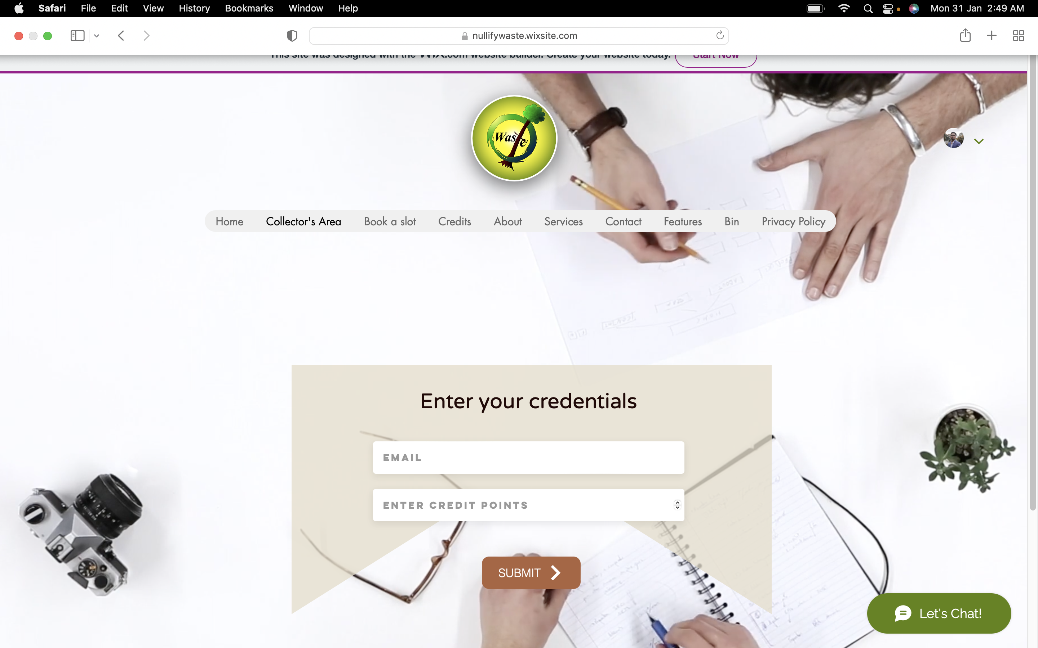
A quick tour of our website
6
Collector’s area
The collector’s area provides an interface for the collector to assign credits to a customer after their waste pickup.

Slide 7
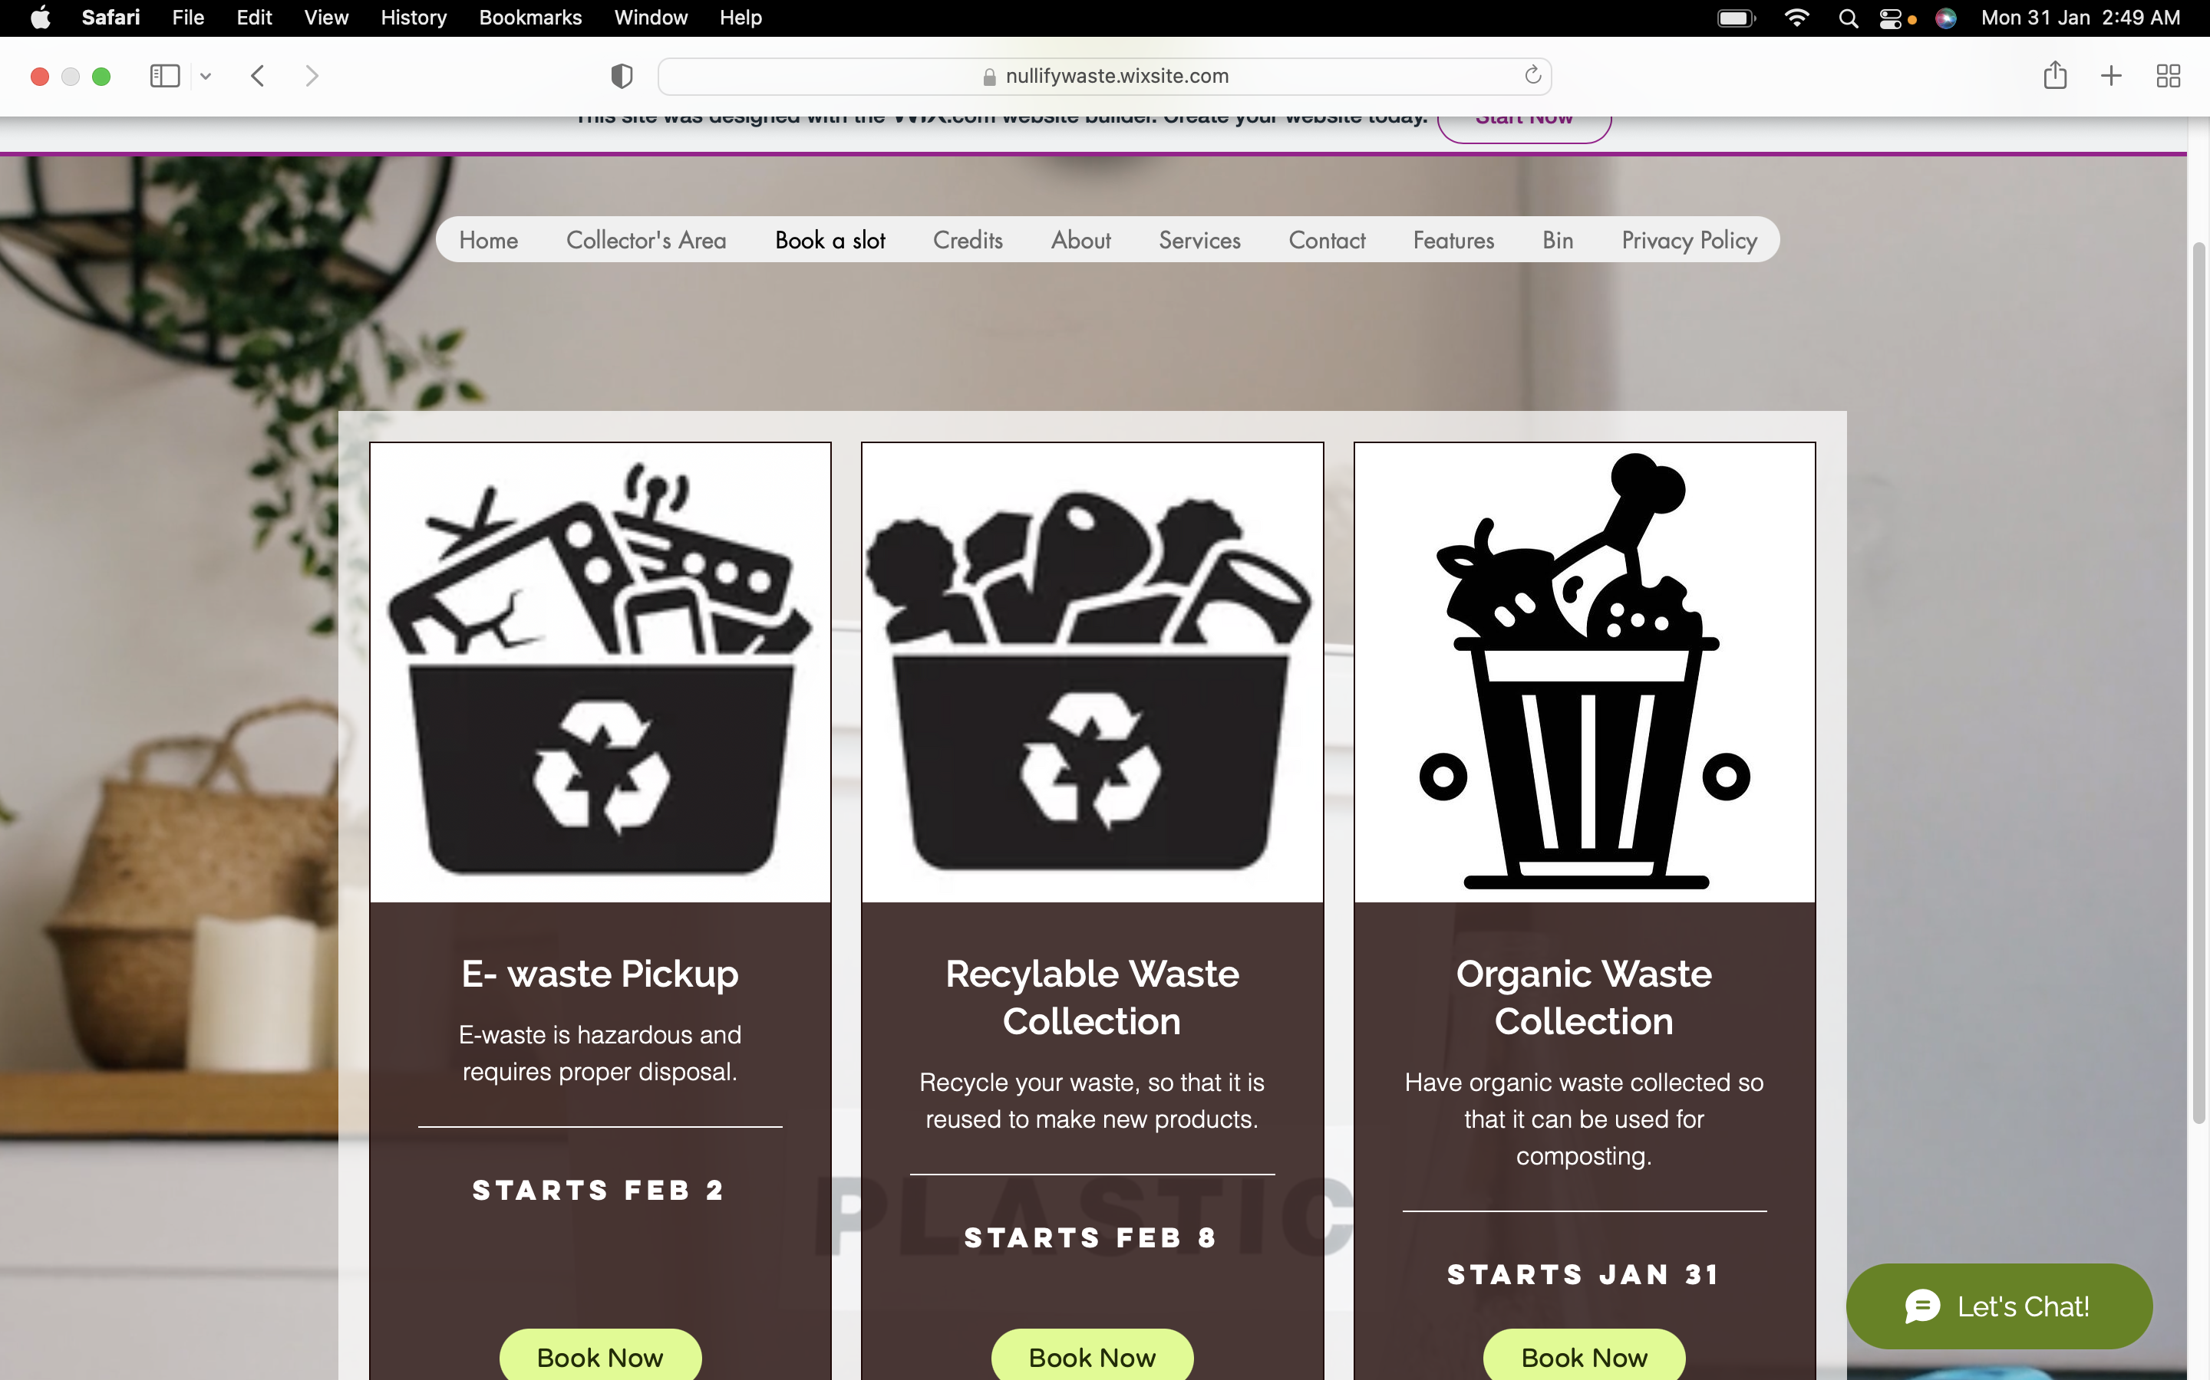
A quick tour of our website
7
Book a slot
The Book a slot page presents the users with the option to book the type of waste they would want to dispose of.

Slide 8
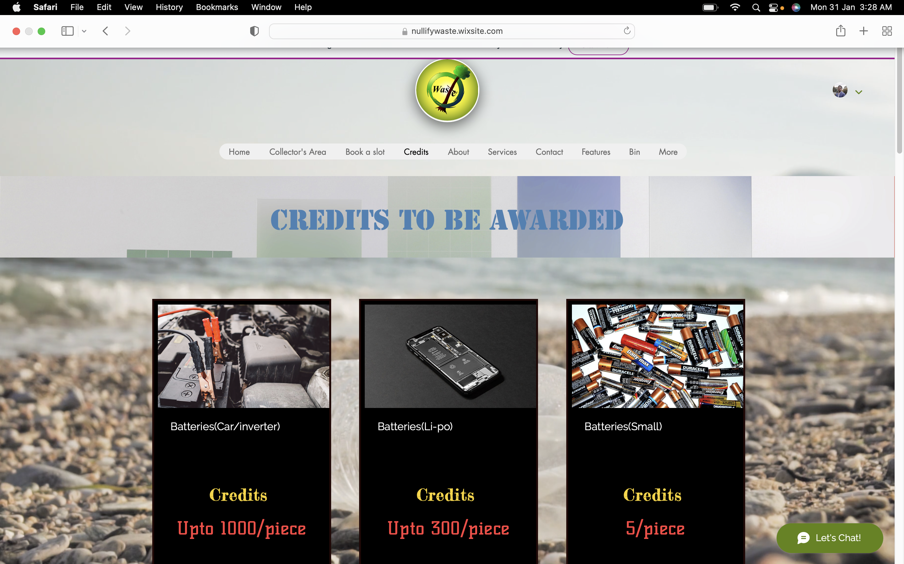
A quick tour of our website
8
Credit system
The credit awards page shows a list of the number of credits that will be given for disposing of a particular type of waste.

Slide 9
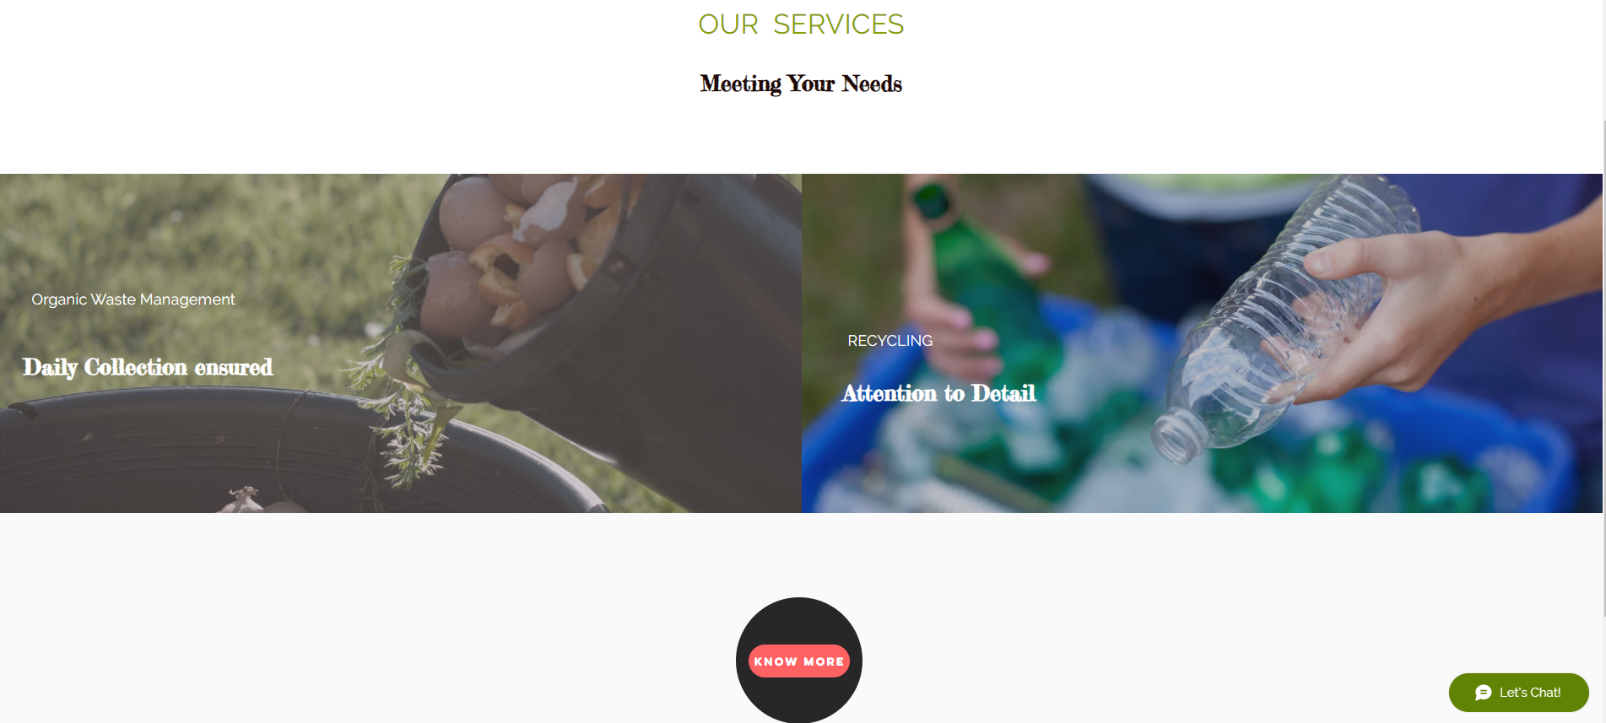
A quick tour of our website
9
Our services
A page showing the list of services we provide.

Slide 10
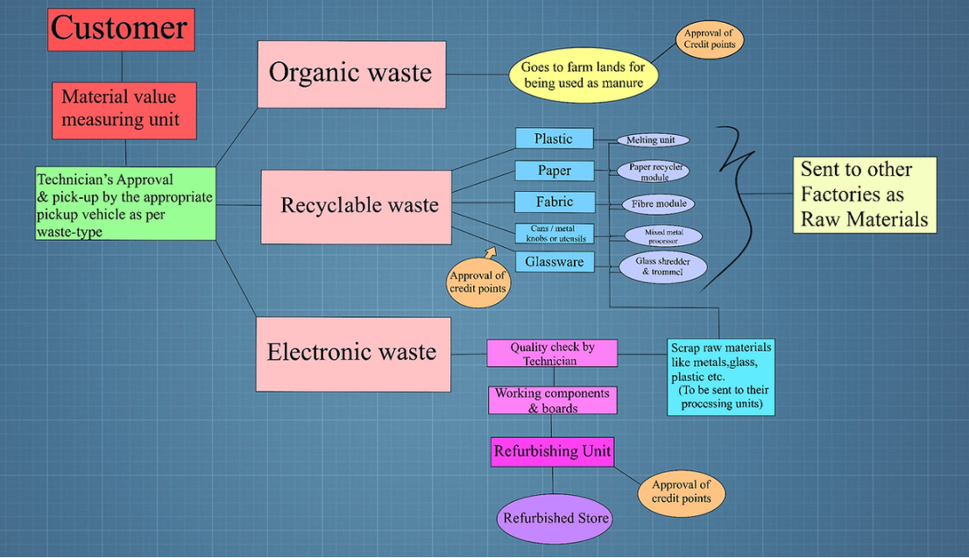
A quick tour of our website
10
Journey of your waste

Slide 11
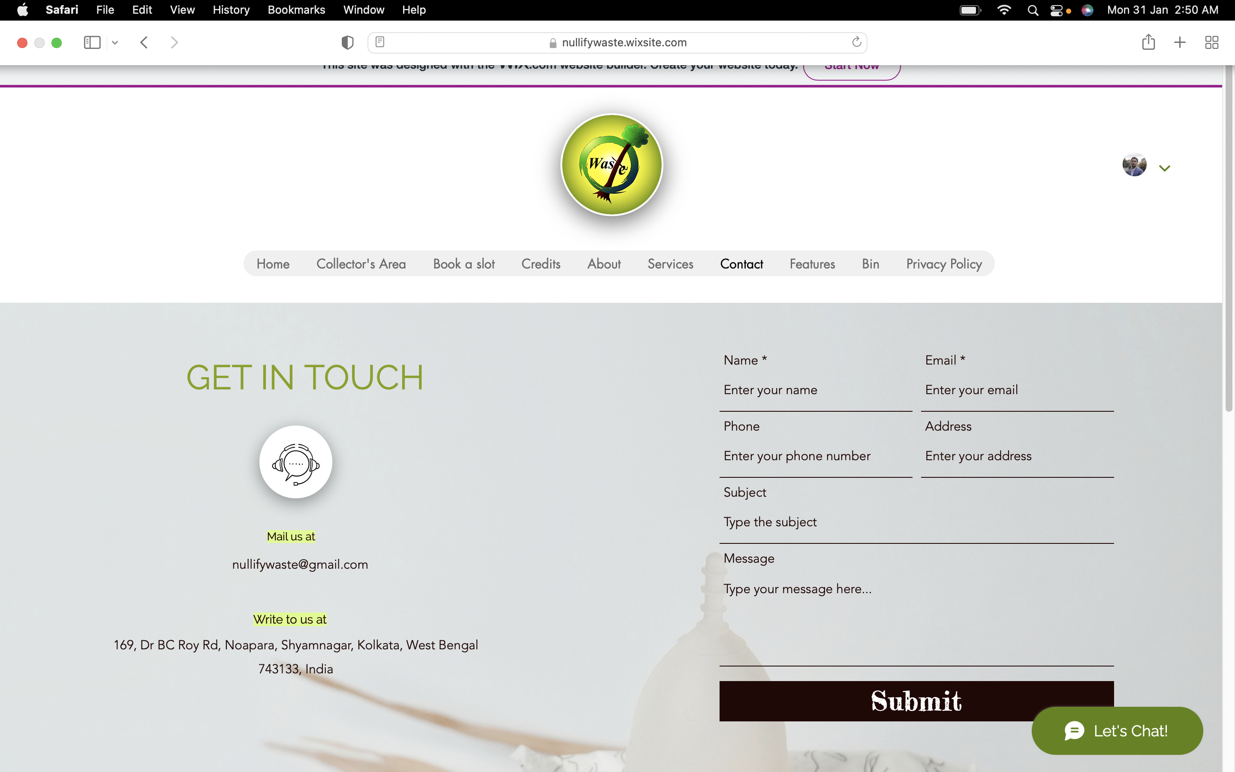
A quick tour of our website
11
Contact us
A page designed for customers to get in touch with us.

Slide 12
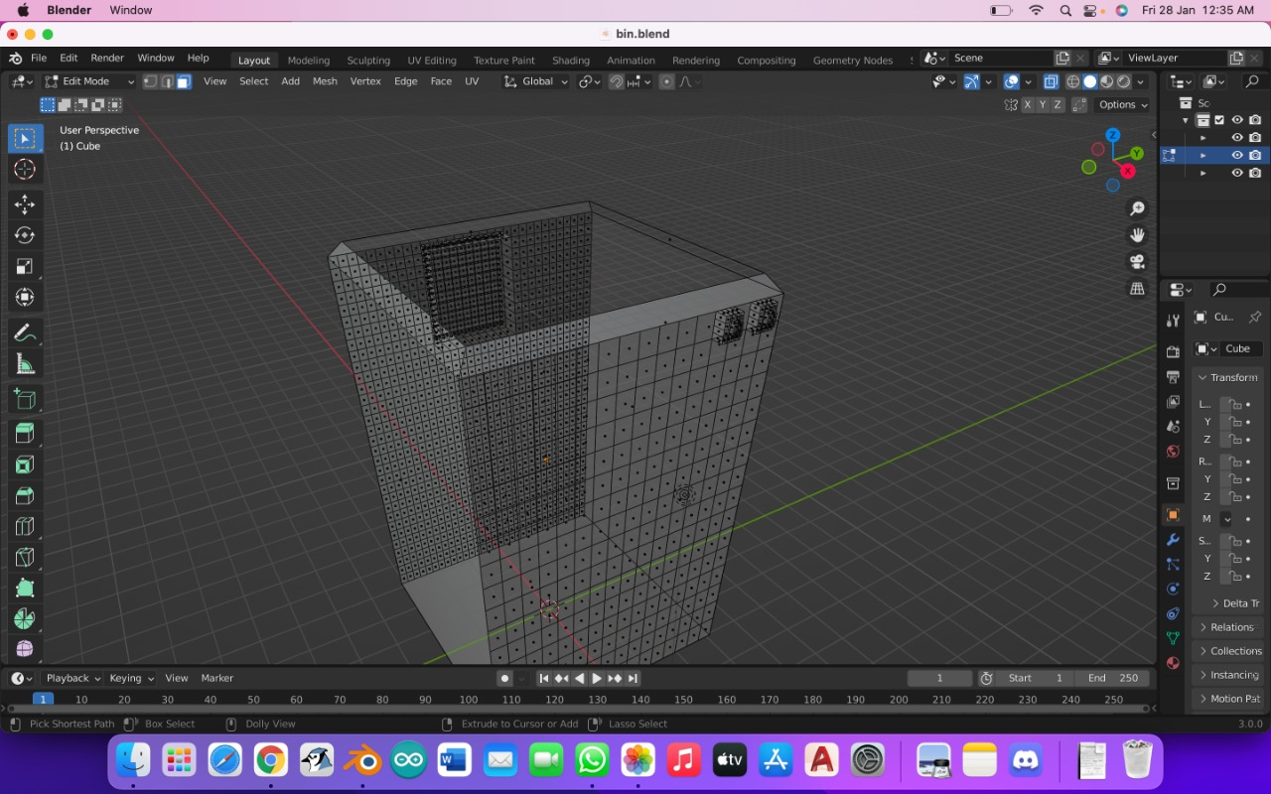
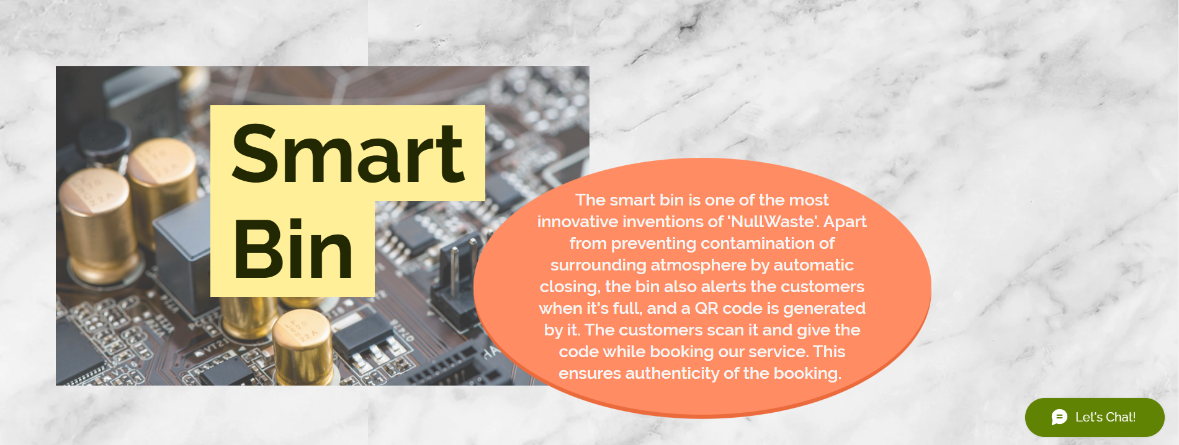
A quick tour of our website
12
The smart bin-in detail

Slide 13
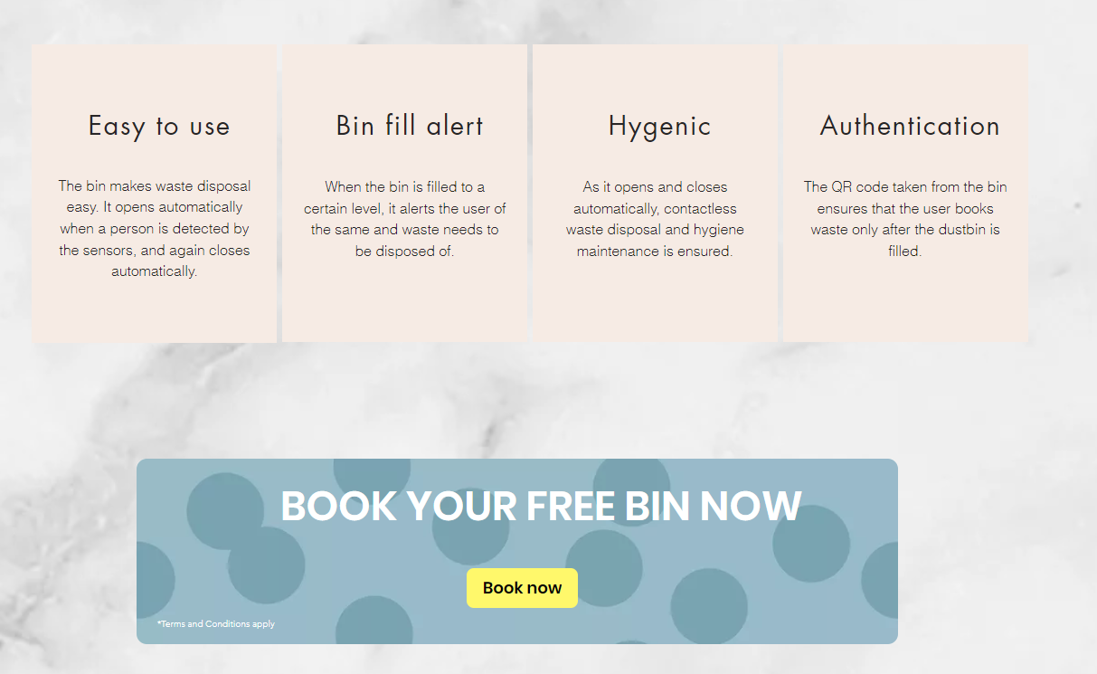
A quick tour of our website
13
The smart bin-in detail

Slide 14
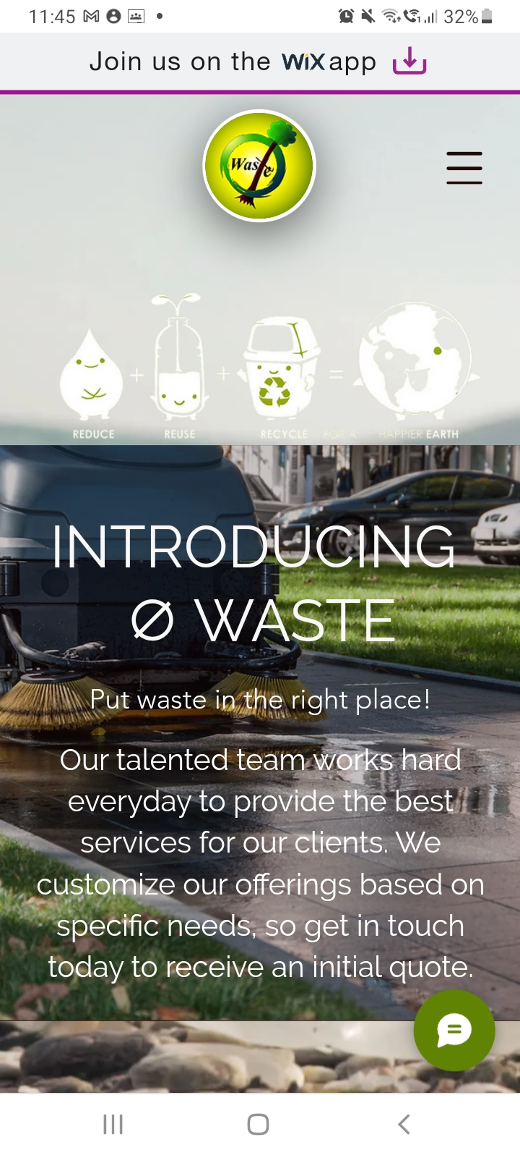
14
We have our website specifically optimised for viewing in mobile too.

Slide 15
THANKS!

